Slide 1
Railway Management System
Use case diagram

Slide 2
Subsystems
User manipulation subsystem
Information subsystem
Online ticketing subsystem
Administration subsystem

Slide 3
Subsystem One
User manipulation

Slide 4
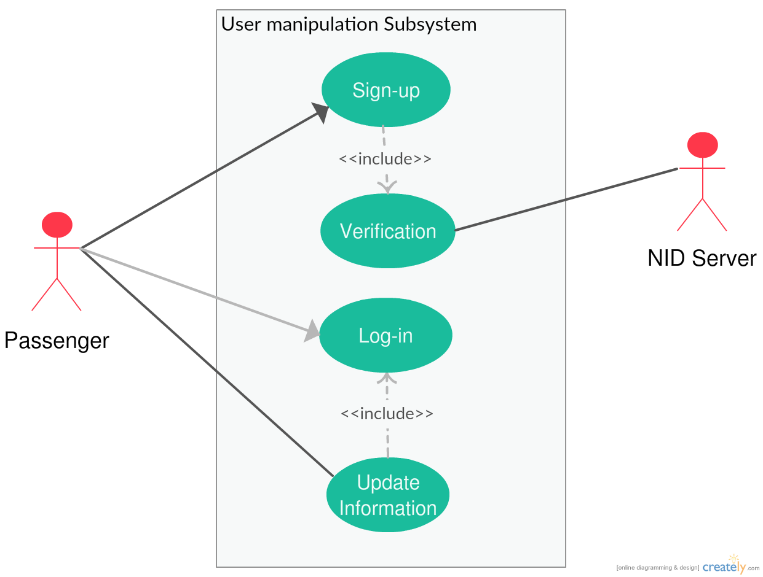
Use case diagram for User manipulation Subsystem

Slide 5
Glossary for User Manipulation Subsystem
Use case name | Actors | Description
Sign up | Passenger (Primary) | This use case describes the event of creating a new account for the passenger.
Log in | Passenger (Primary) | This use case describes the event of entering in an existing account.
Account Verification | Passenger(Primary) NID server | This use case describes the event of verification of mobile number against NID and other verification while creating an account.
Update information | Passenger (Primary) | This use case describes the event of updating account information.

Slide 6
Use Case Narrative: Account Verification
Use Case Name: | Account Verification
Priority: | High
Primary Actor: | Passenger
Secondary Actor: | NID Server
Precondition: | The individual submitting the information must have NID number and verified mobile number.
Trigger: | This use case is initiated when a Sign Up is submitted.
Description: | When a user tries to sign up this case occurs to verify whether he has given all the correct information or not.

Slide 7
Use Case Narrative (continued)
Typical Course of Events:
Actor Action | System Response
Step 1 : User will provide NID number and mobile number along with some other information. | Step 2 : System will check the validity of the NID. Step 3 : System will then check whether the mobile number is registered to the NID or not. Step 4 :If all the above steps are done successfully then an auto generated code will be sent to the mobile number which the user have to enter into the signup window within 2 minutes.

Slide 8
Subsystem Two
Information

Slide 9
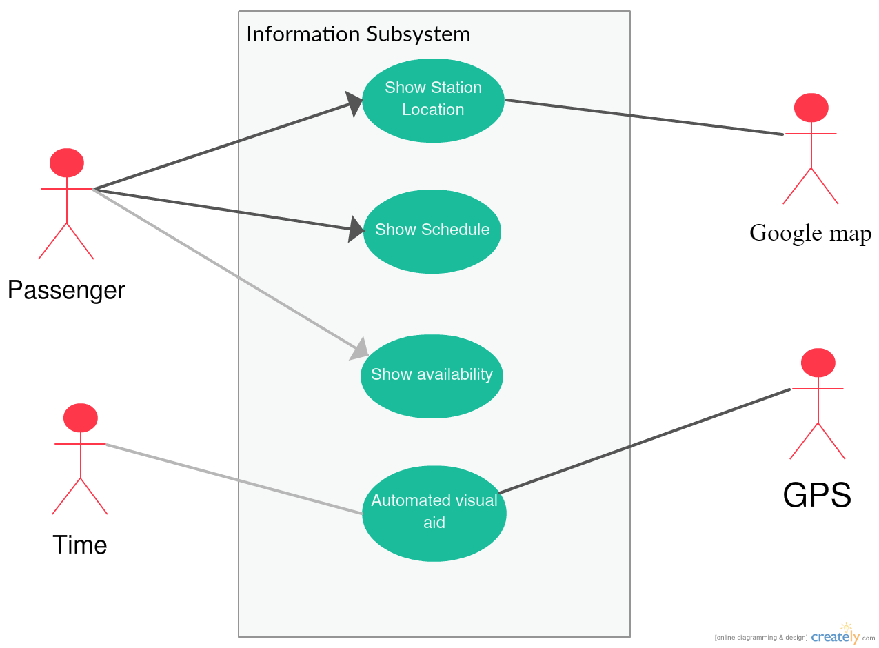
Use case diagram for Information Subsystem

Slide 10
Glossary for Information Subsystem
Use case name | Actors | Description
Show station location | Passenger(Primary) Google map (Secondary) | This use case describes the event of showing exact station location via google map.
Show schedule | Passenger (Primary) | This use case describes the event of entering in an existing account.
Show availability | Passenger (Primary) | This use case describes the event of verification of mobile number against NID and other verification while creating an account.
Automated visual aid | Time(Primary) GPS(Secondary) | This use case describes the event of updating account information.

Slide 11
Use Case Narrative : Automated Visual Aid
Use Case Name: | Automated Visual Aid
Priority: | High
Primary Actor: | Time
Secondary Actor: | GPS System
Precondition: | None
Description: | The current location of all the trains and how much time is needed to reach the station is being showed in a Television screen which is automatically updated with the information of GPS system installed within the trains.

Slide 12
Use Case Narrative (continued)
Typical Course of Events:
Actor Action | System Response
Step 1 : After 2 minutes the monitor screen will automatically be refreshed. | Step 2 : The system will get the current location of each train and the speed. Step 3 : Then it will calculate the approximate arrival time of a specific train at specific station. Step 4 :Then the data will be sent to the visual aid for the passengers on the station.

Slide 13
Subsystem Three
E Ticketing

Slide 14
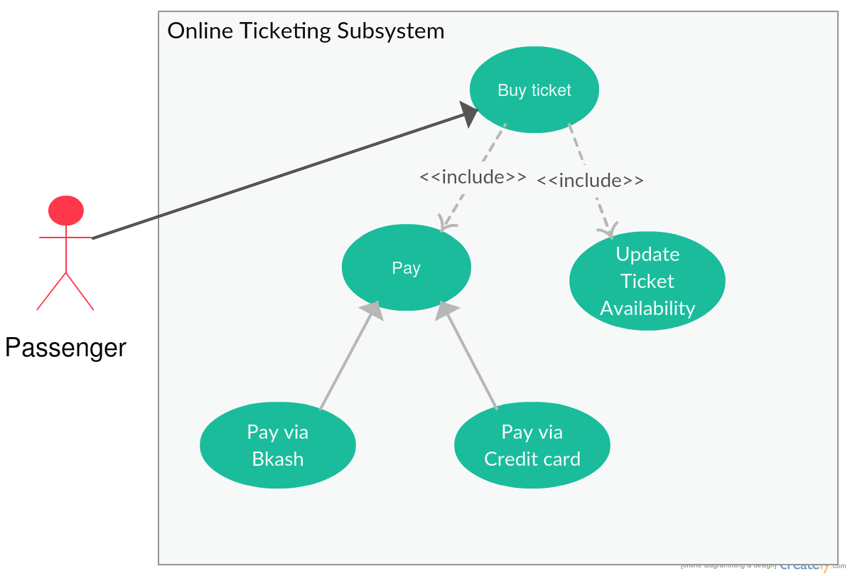
Use case diagram for Online Ticketing Subsystem

Slide 15
Glossary for Online Ticketing Subsystem
Use case name | Actors | Description
Buy ticket | Passenger (Primary) | This use case describes the event of buying ticket.
Pay | Passenger (Primary) | This use case describes the event of paying for ticket .
Pay via bKash | Passenger (Primary) | This use case describe the event of make payment for tickets via Bkash.
Pay via Credit card | Passenger (Primary) | This use case describe the event of make payment for tickets via credit card.
Update ticket availability |  | This use case describes the event of updating available ticket information after selling ticket.

Slide 16
Use Case Narrative: Buy Ticket
Use Case Name: | Buy Ticket
Priority: | High
Primary Actor: | Passenger
Secondary Actor: | None
Precondition: | The passenger must have logged into a valid user account.
Trigger: | This use case is initiated when a buy ticket request is submitted.
Description: | When a passenger clicks to buy a ticket the internal database will verify whether he has bought more than 8 tickets in the current month and will restrict one user to 4 tickets at one time per NID.

Slide 17
Use Case Narrative (continued)
Typical Course of Events:
Actor Action | System Response
Step 1 : Passenger specifies the route and ticket class. | Step 2 : System checks whether ticket is available. Step 3 : If available then checks whether the passenger has purchased 8 or more tickets per month. Step 4 : If not then system automatically charges money through credit card or bKash Step 5 : A copy of the ticket is sent to the email address of the passenger in pdf format having a Auto generated serial number.

Slide 18
Subsystem Four
Administration

Slide 19
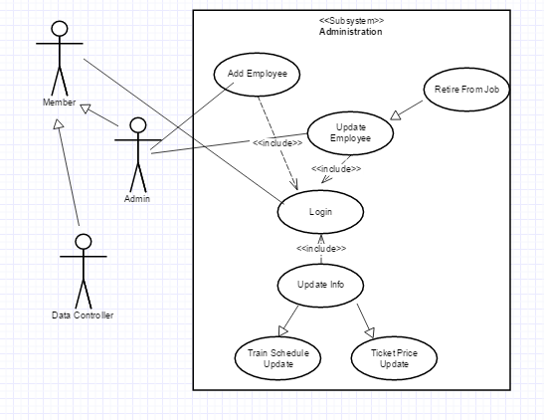
Use case diagram for Administration Subsystem

Slide 20
Glossary for Administration Subsystem
Use case name | Actors | Description
Update employee database | Database controller (Primary) | This use case describe the event of updating employee information.
Add employee | Admin (Primary) | This use case describe the event of recruiting new employee .
Retire from job | Admin (Primary) | This use case describe the event of updating database if an employee retires .
Log in | Member (Primary) | This use case describe the event of Log into account for employee.
Update information | Admin (Primary) | This use case describe the event of Updating various information about train.
Train schedule update | Database controller (Primary) | This use case describe the event of updating train schedule.
Ticket price Update | Database controller (Primary) | This use case describe the event of Updating ticket price.

Slide 21
Use Case Narrative : Update Info
Use Case Name: | Update Info
Priority: | Medium
Primary Actor: | Data Controller
Secondary Actor: | None
Precondition: | User must have logged in an admin or data enroller account.
Trigger: | None
Description: | The information about the fair of the ticket fare and the scheduling of the trains can change over time. This case will handle those.

Slide 22
Use Case Narrative : Update Info (continued)
Typical Course of Events:
Actor Action | System Response
Step 1 : Data controller enters if any ticker price or train schedule is changed over time. | Step 2 : The system verifies the authority of the data controller. Step 3 : If verified then the system waits for the approval of the admin. Step 4 : If admin approves then the system automatically updates the database holding these information. Step 5 : In the website the changes are showed via notification to the corresponding passengers.

Slide 23
Thank You

